Slide 1
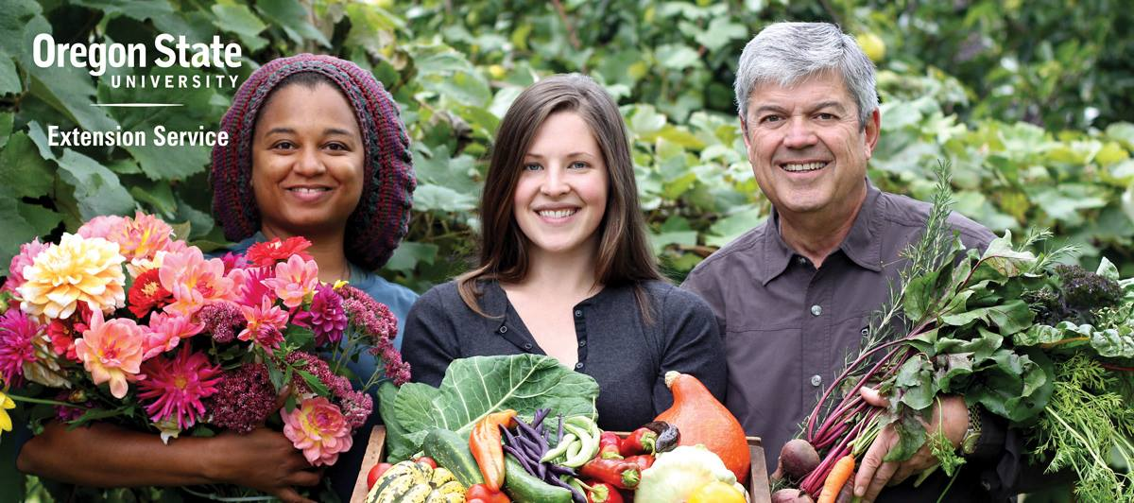
Changing Image
Right click on image and select “Change Picture.”
m Master Gardener™ Program METRO AREAeet

Slide 2
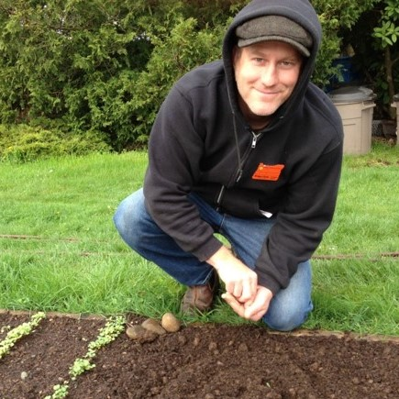
OSU Master Gardener™ Program
Helps Oregonians grow healthy gardens​
Provides gardening information rooted in science
More than 3,000 trained volunteers provide 200,000 volunteer hours and 250,000 contacts annually​
Requires annual volunteer recertification

Slide 3
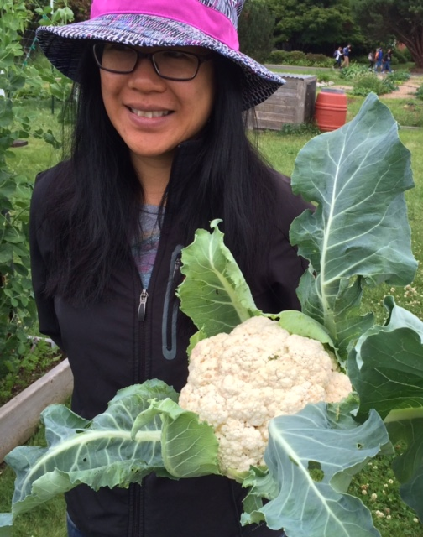
OSU Master Gardener Mission
Cultivating resilient and healthy communities throughout Oregon through sustainable horticulture education and gardening projects that are rooted in science and that are supported by OSU Extension volunteers.

Slide 4
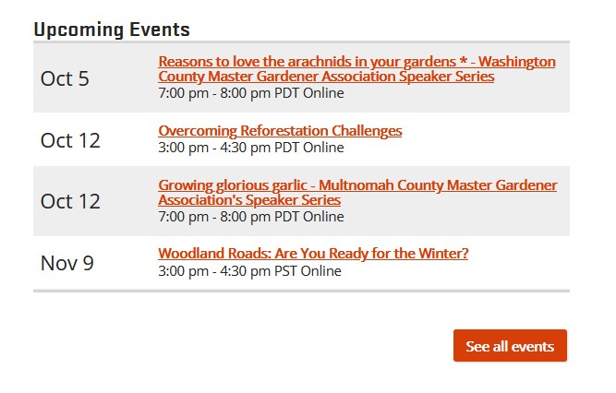
OSU Extension Service Metro area Master Gardener Program Events Calendar
Find our upcoming events at:
www.metromastergardeners.org
Look at the bottom of the page - Free webinars, all welcome! - Register in advance
Nov 10 Gather: A film and discussion about
Native American Food Sovereignty
7:00 pm - 9:00 pm PST Online

Slide 5
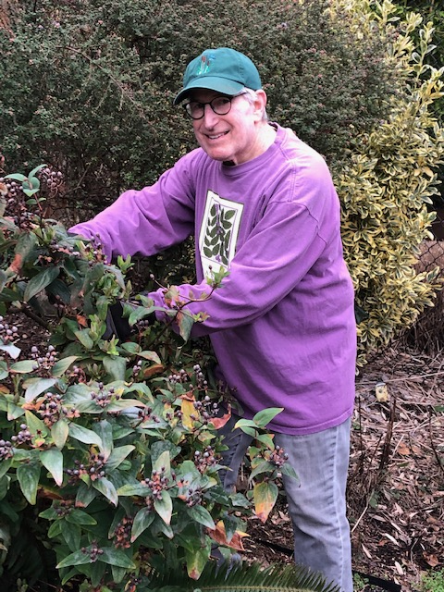
Hello!
Jack Shorr
(pronouns he, him, his)
OSU Extension
Service Master Gardener Volunteer
I am both an MG (Master Gardener) and an MN (Master Naturalist). I love attracting native pollinators with native plants and seasonal blooms and have recently installed a lawn alternative featuring clover.

Slide 6
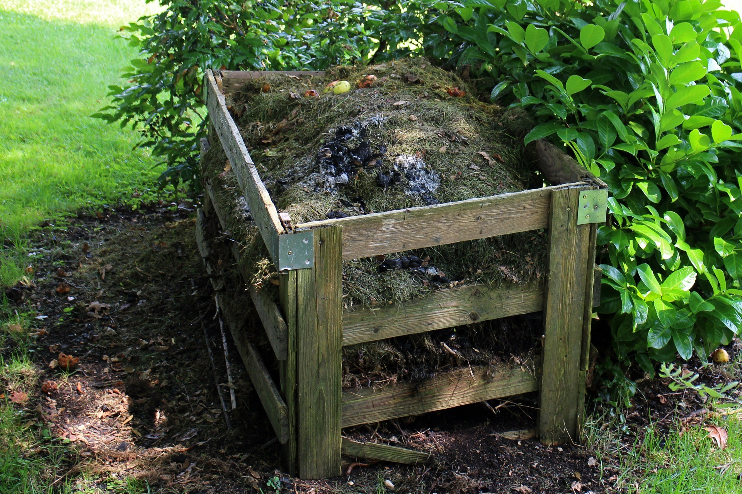
COMPOSTING 101
Why Compost?
Improves soil structure
Retains water
Decreases runoff
Feeds beneficial soil
organisms

Slide 7
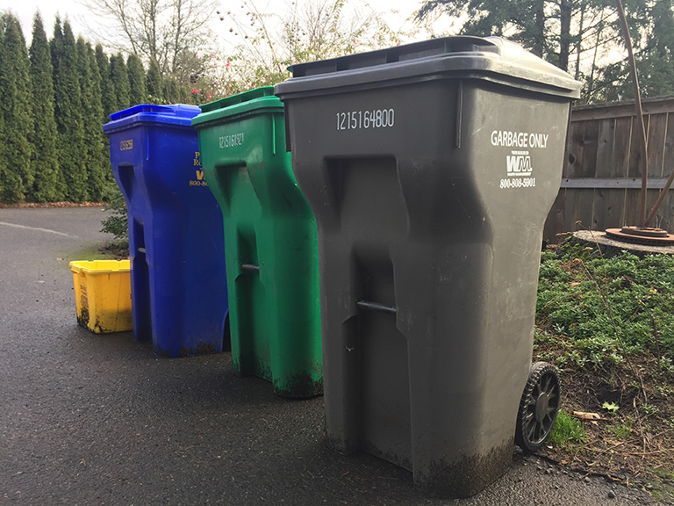
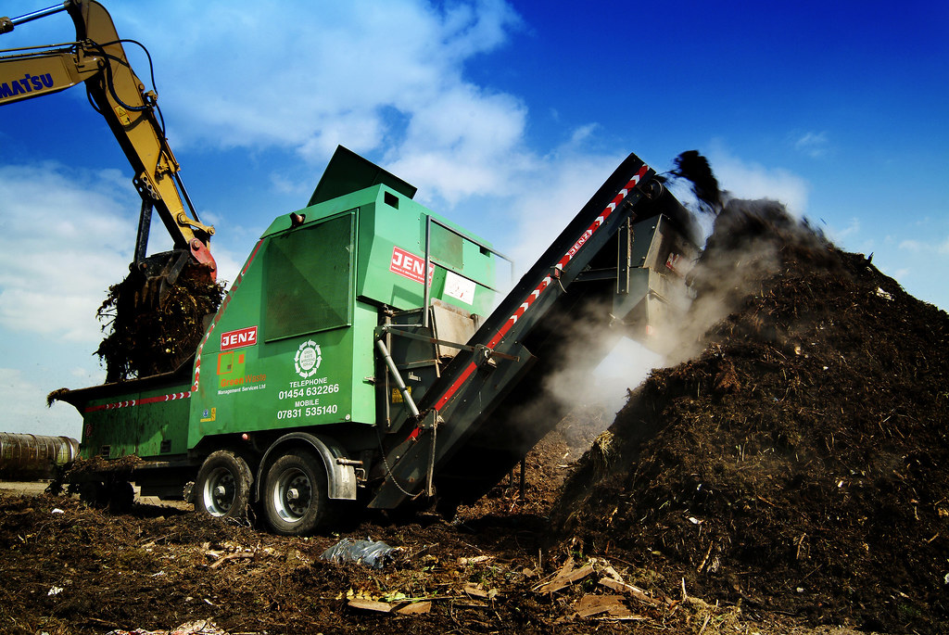
COMPOSTING 101
Municipal Composting is Your Best Option
Use Green Waste Bin

Slide 8
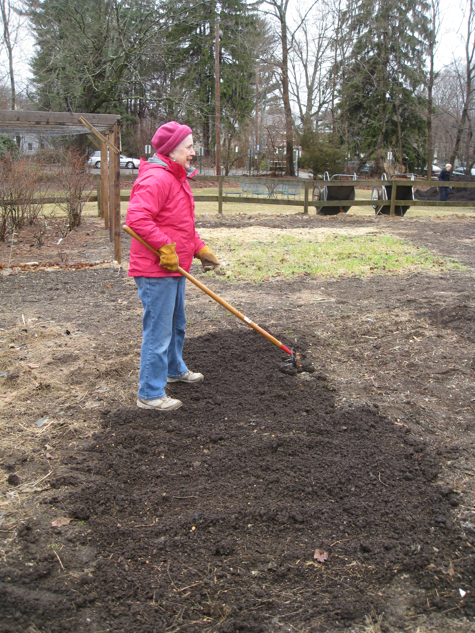
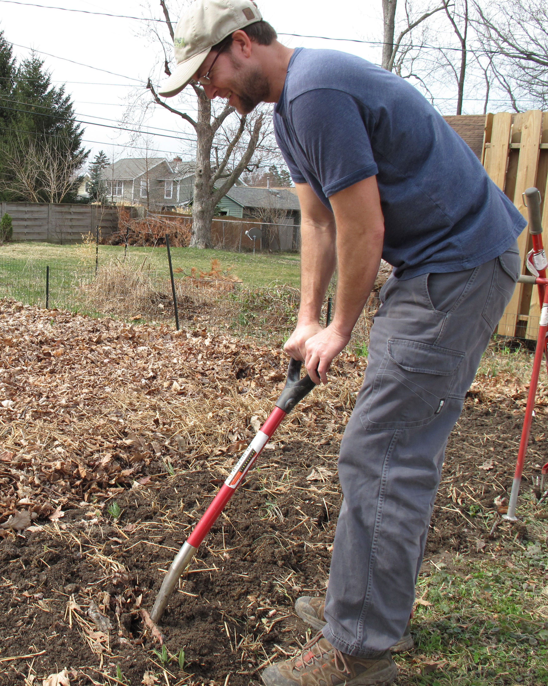
COMPOSTING 101
How to Use Compost in Gardens and Landscapes
Cover soil with 1-3 inches of compost
Dig it into the soil

Slide 9
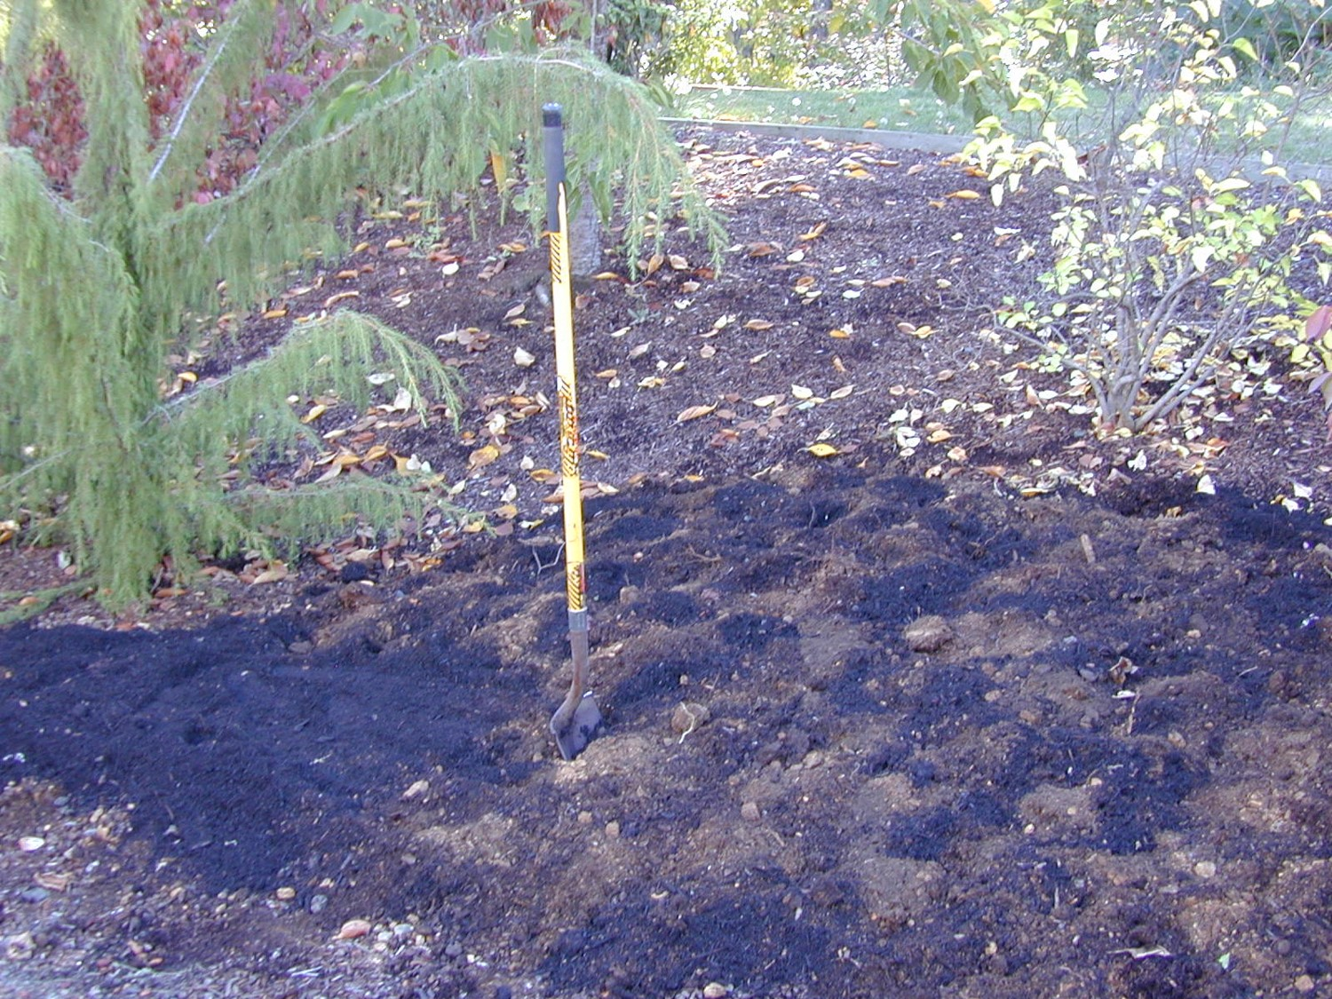
COMPOSTING 101
Incorporate Compost Before Planting

Slide 10
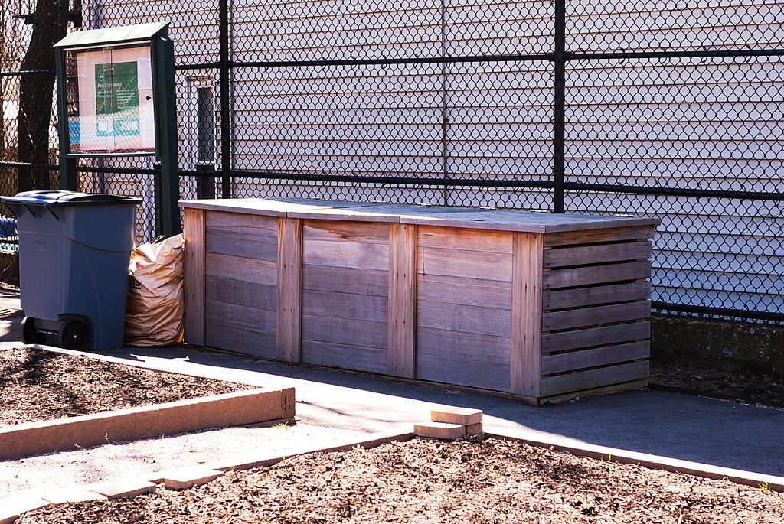
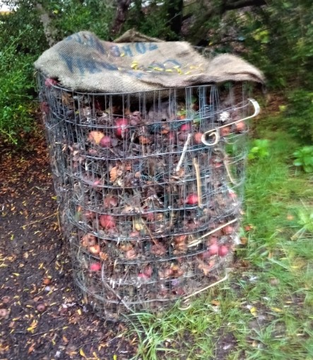
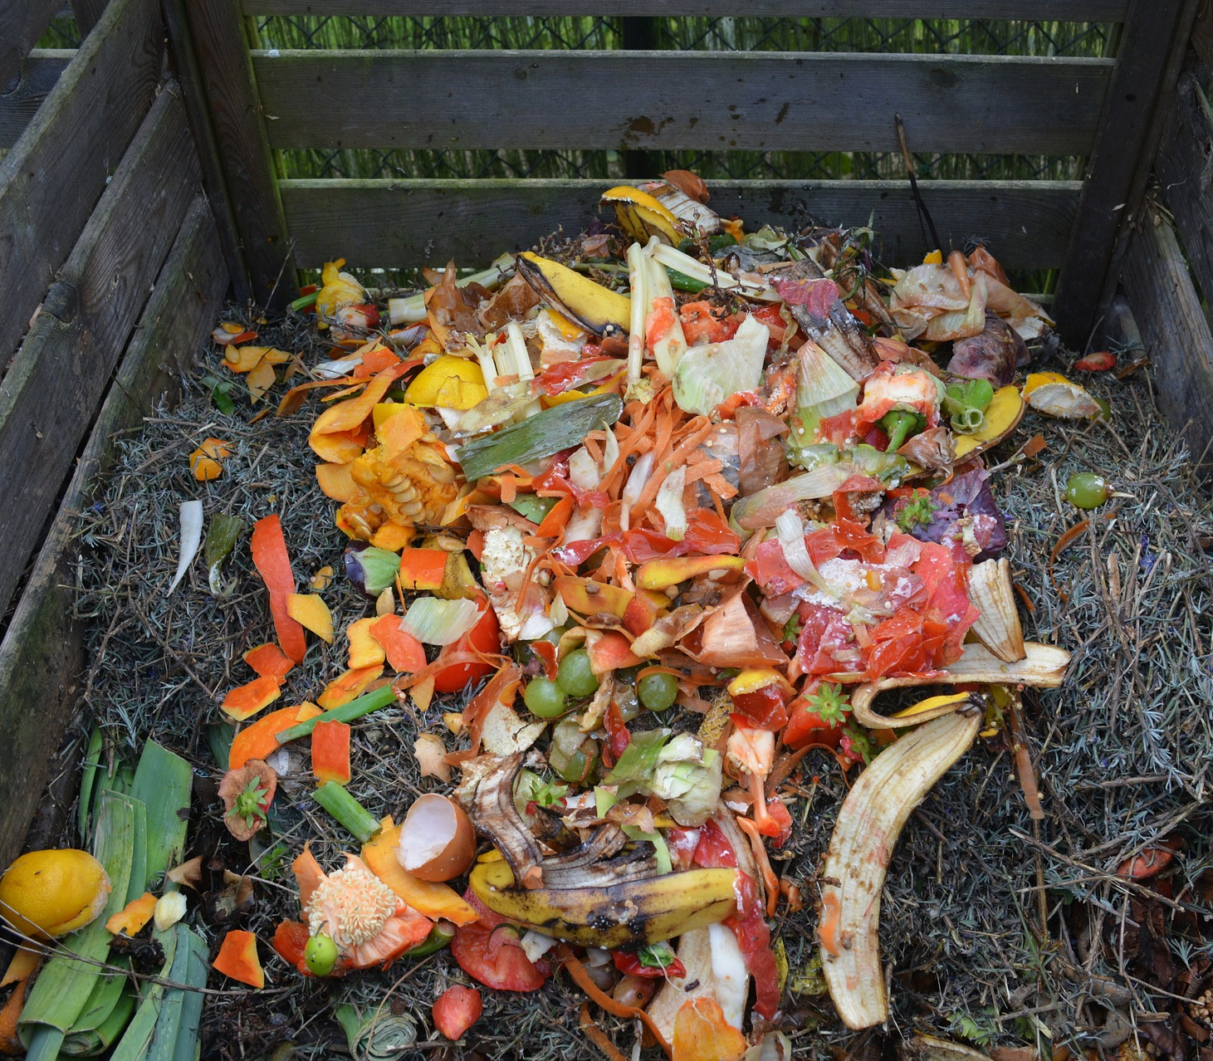
COMPOSTING 101
Choosing a Home Composting System for Food Scraps
Use rat-proof bins
Don’t attract rats with food scraps: Not recommended

Slide 11
COMPOSTING 101
Sheet mulch composting
AKA Lasagna composting, converts grass to beds, enlarges borders, improves soil
Fall is a good time to start
Place browns and greens directly on the soil
Place alternate layers of materials on top of the ground covered with cardboard or overlapping layers of newspaper 18” to 3’
May take 6 months to finish. Burlap and added compost can speed the process

Slide 12
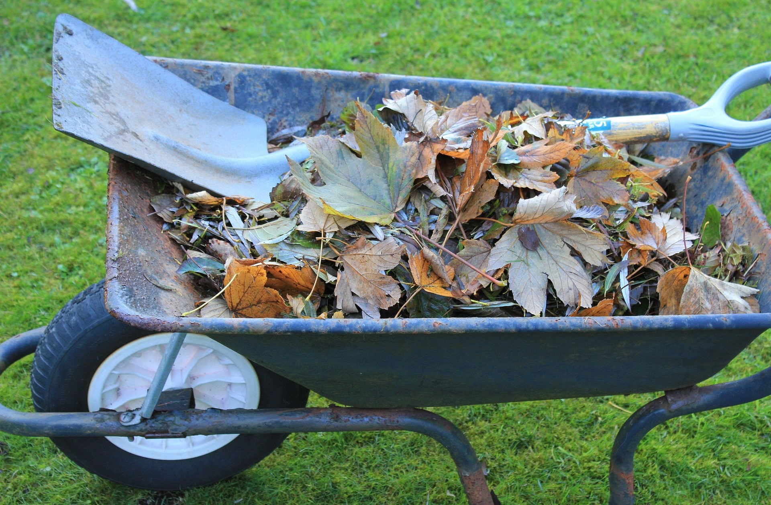
COMPOSTING 101
Low fuss composting
Use leaves and garden trimmings, no kitchen scraps, chop and place in wire bin mix browns and greens

Slide 13
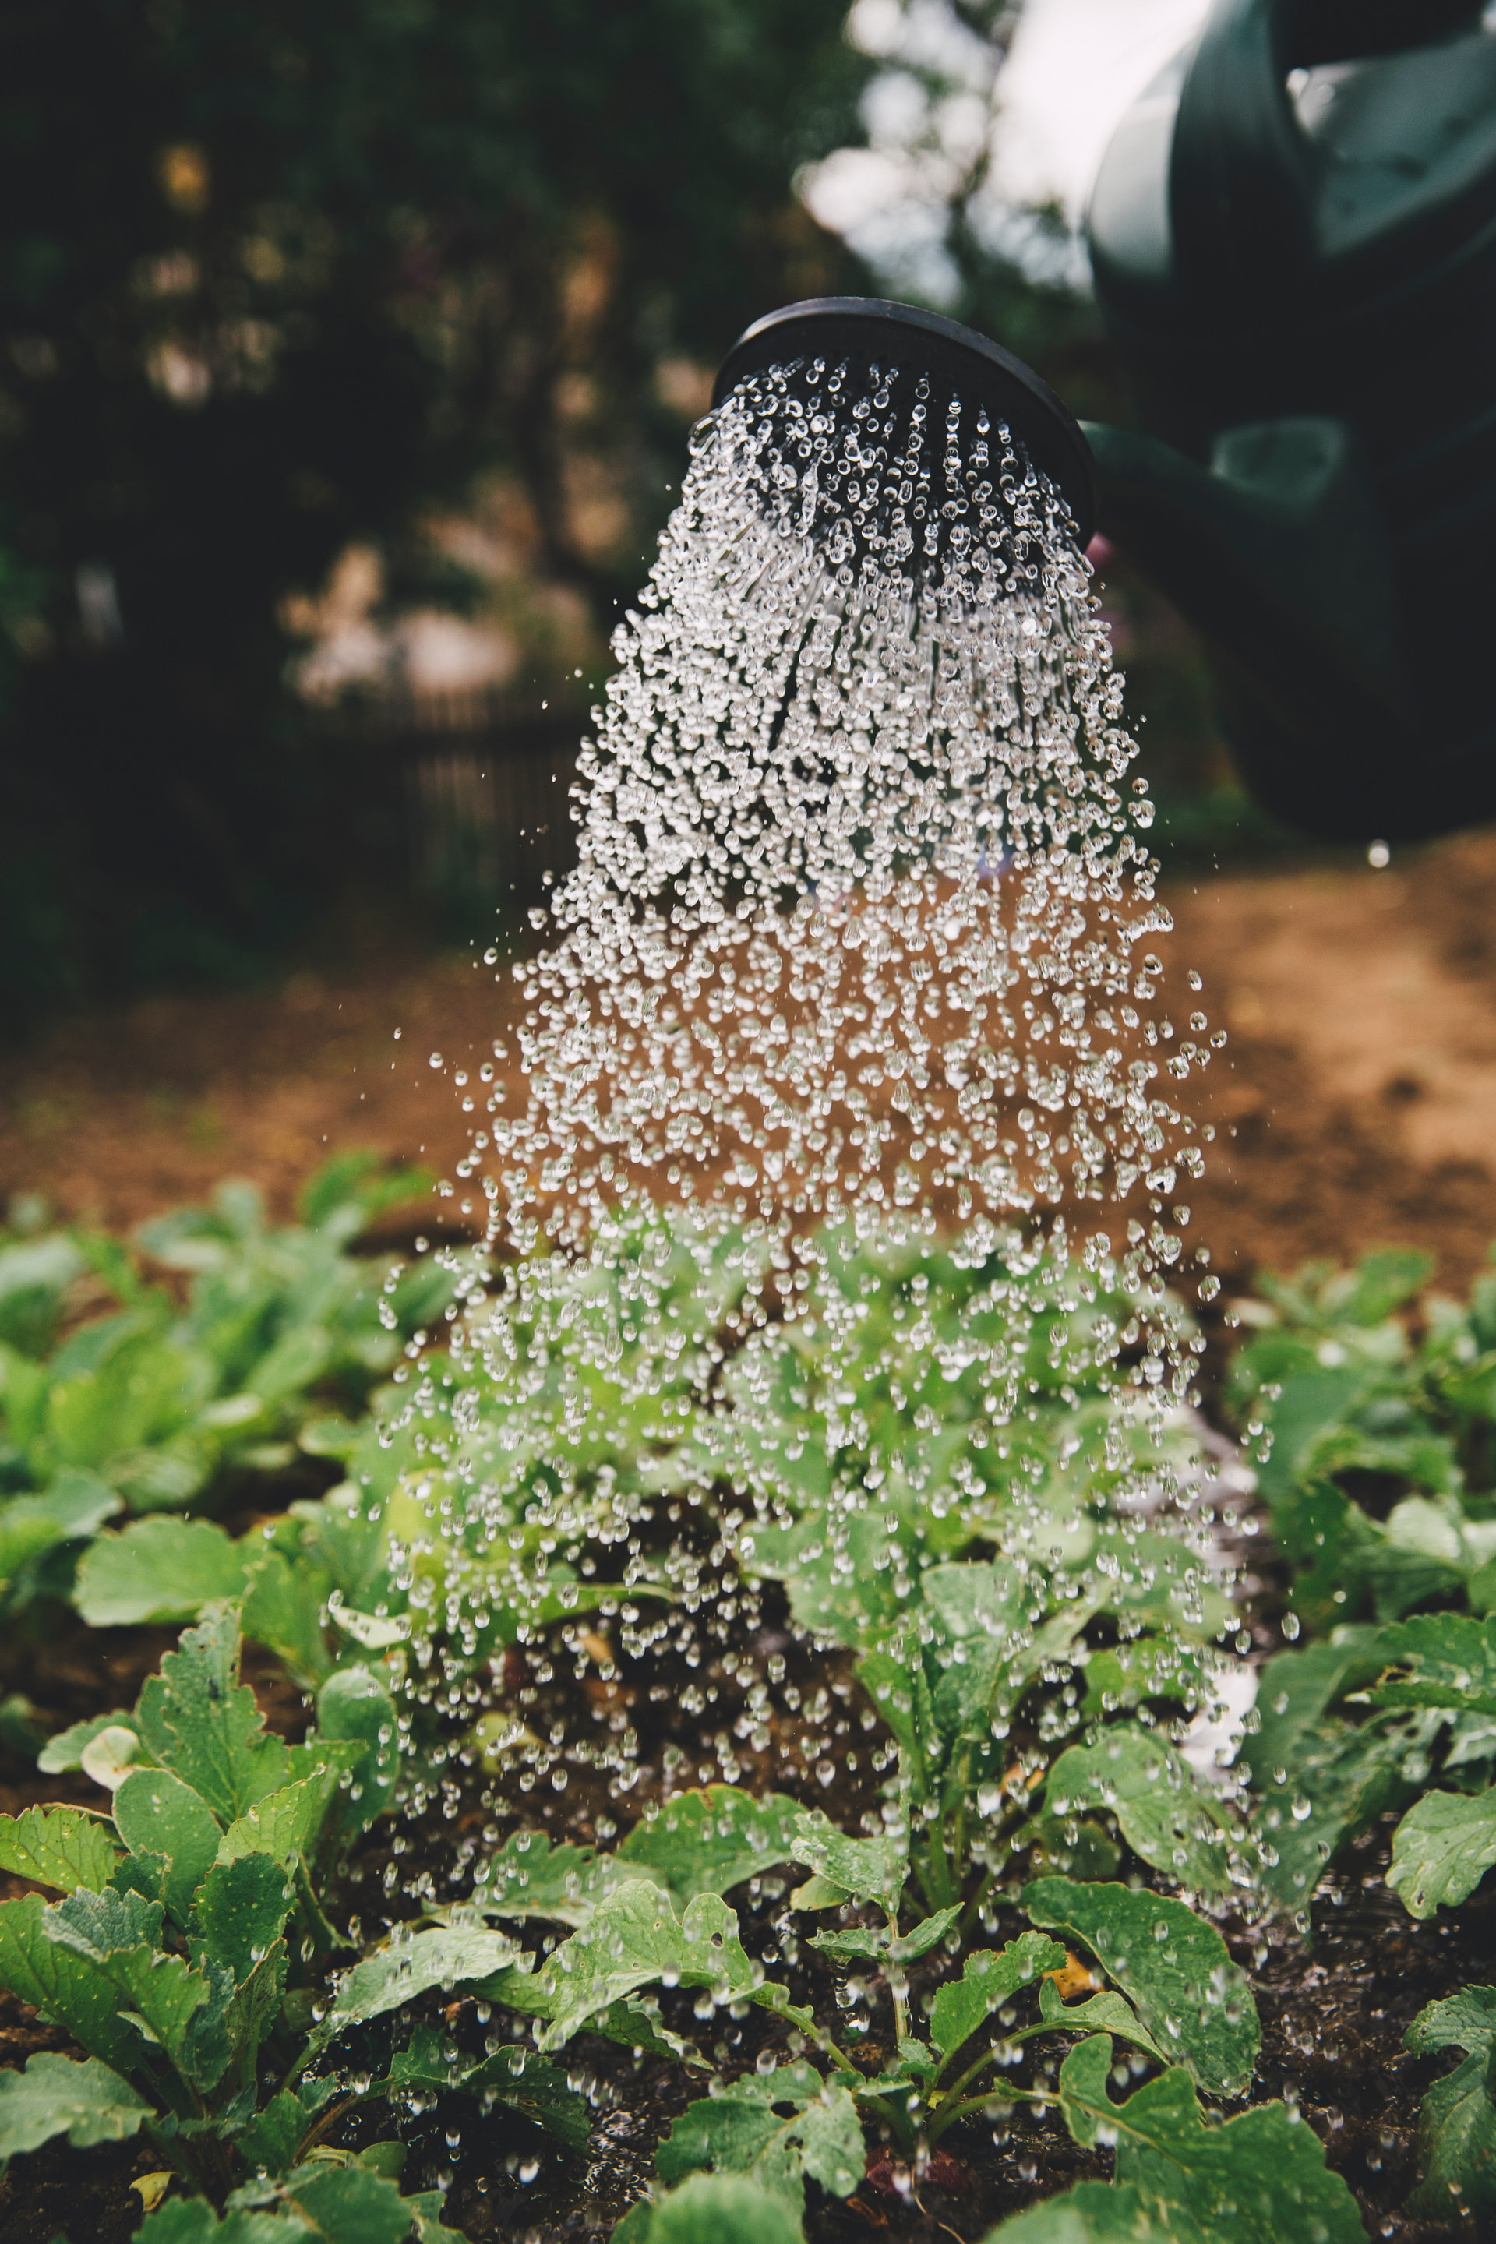
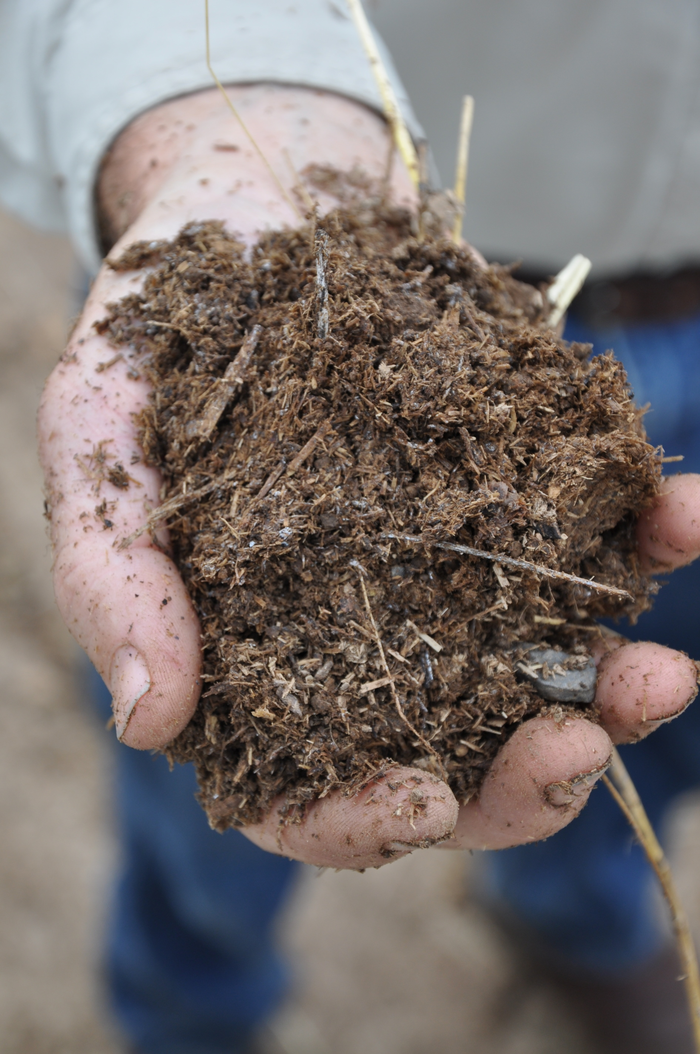
COMPOSTING 101
Add as you go composting
(cool composting)
Use a plastic or wooden bin with ¼” hardware
cloth in the bottom to deter rodents
Add food and yard materials whenever available
Chop/shred browns, add greens with browns
on top
Turn the pile periodically, add water as needed

Slide 14
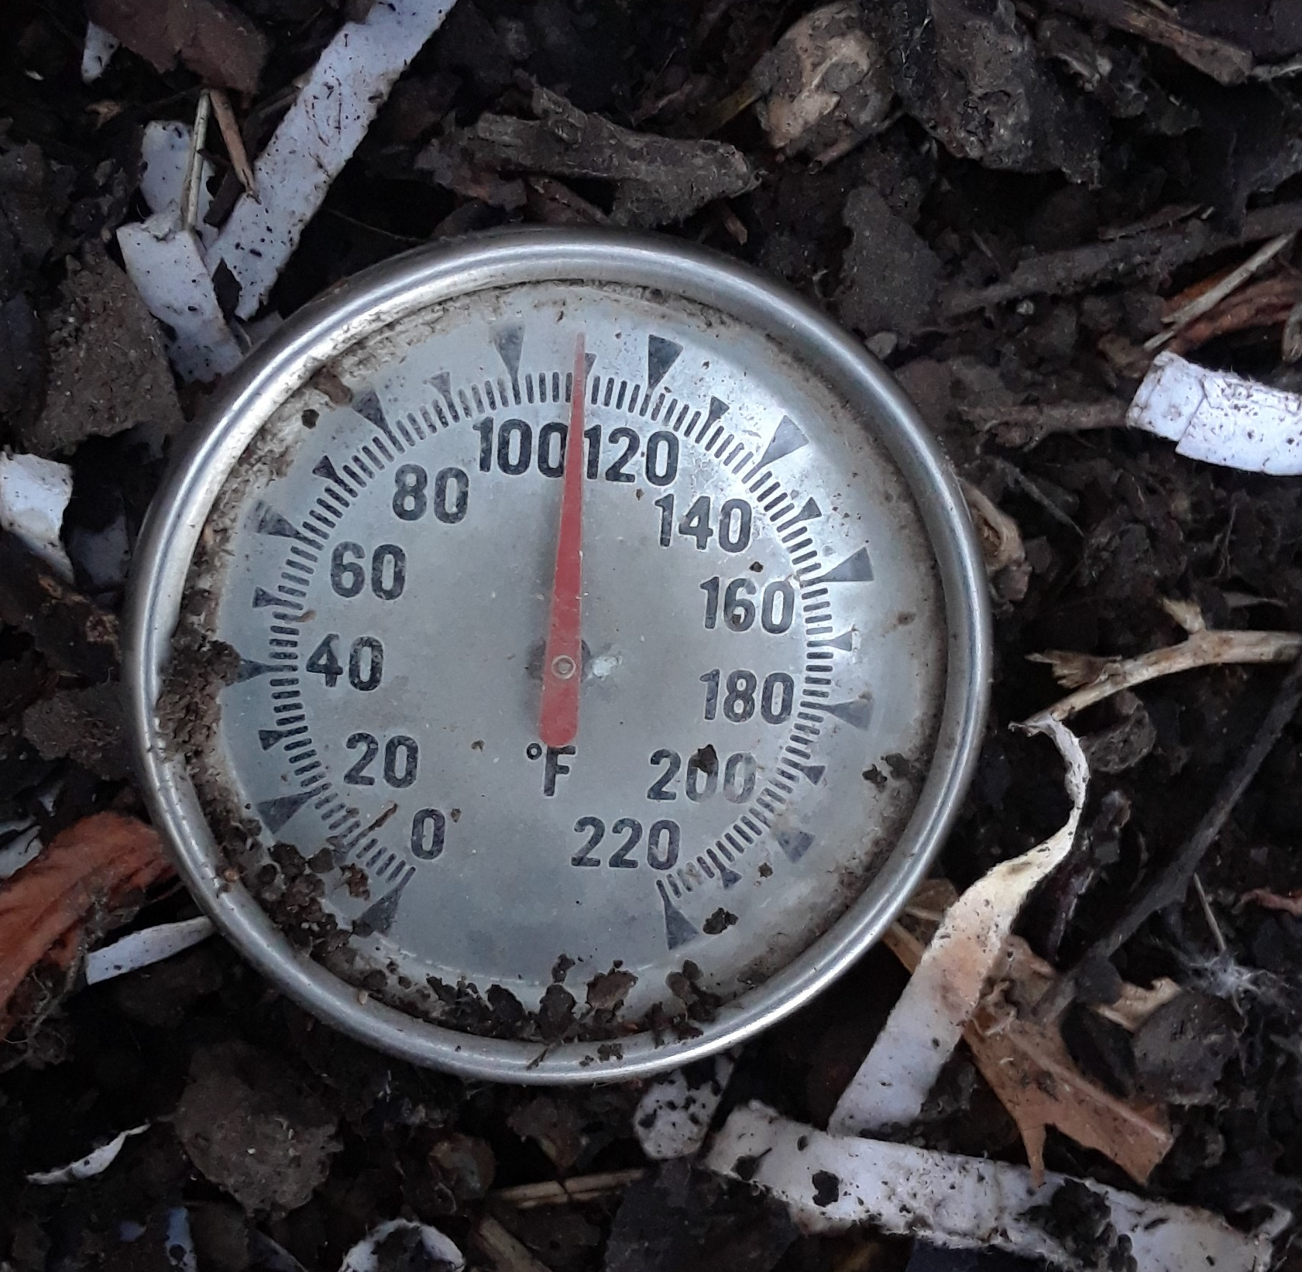
COMPOSTING 101
Make it fast/Hot composting
Requires adequate amounts of green and
browns and time and energy to turn the pile
Create a volume of 3x3x3’ with equal parts
browns and greens add water
If the pile does not heat up add grass, manure
or coffee grounds
Takes about a month and another 4-6 weeks to cure for use with tender plants or veggies
Tumbler composting are popular and keep rodents out but must be rotated regularly

Slide 15
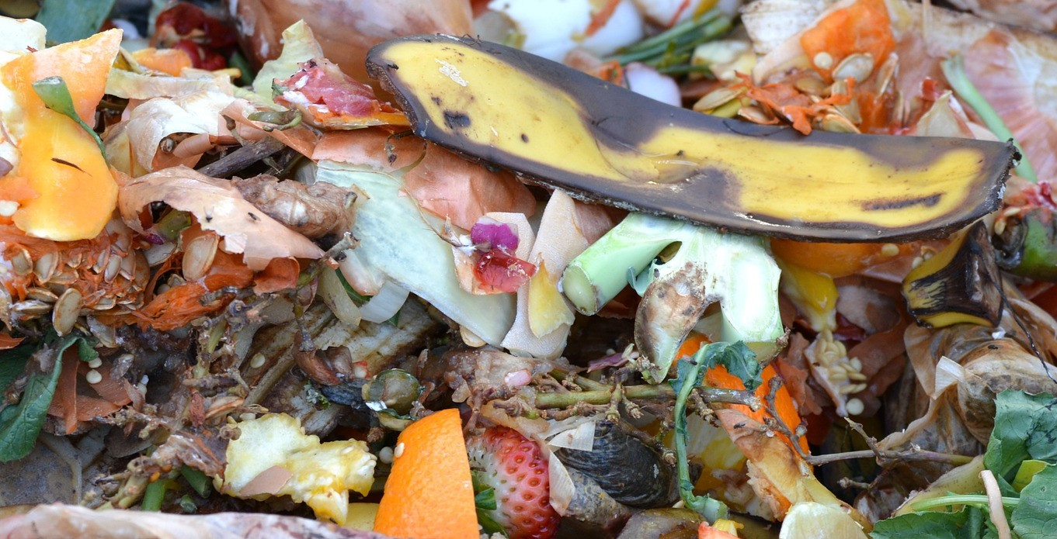
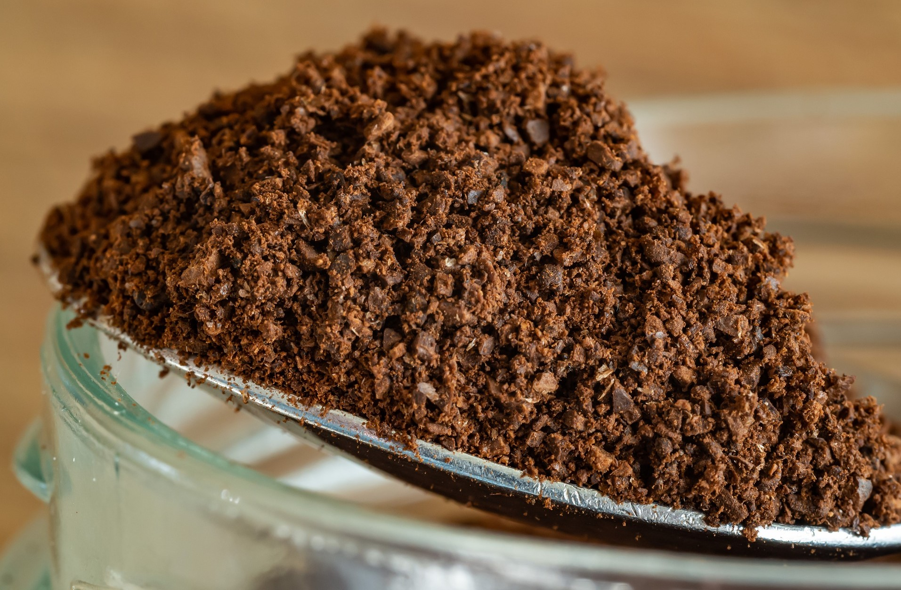
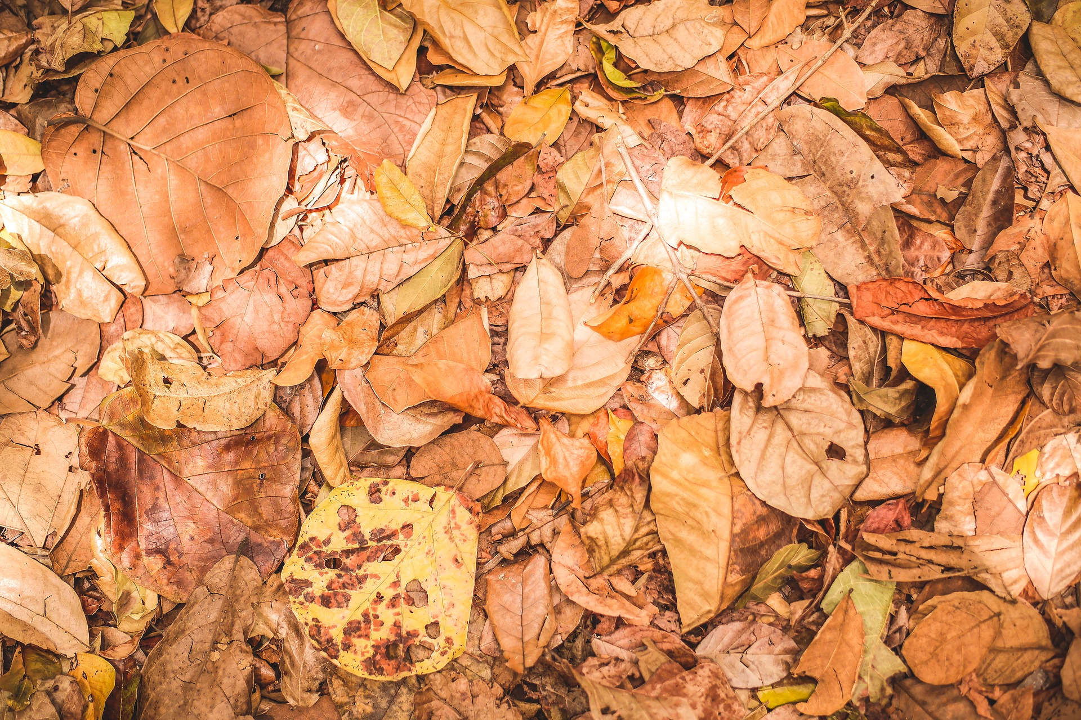
COMPOSTING 101
BUILD AND MAINTAIN A PILE
Bottom layer of browns: leaves, dried flowers, straw, sawdust, shredded paper
Greens next: grass clippings, small prunings, flowers, tea and coffee grounds, fruit and veggie waste, aged manures
Keep pile moist not wet or dry, aerate by turning, chop into 1” pieces, balance layers with brown on top, cover the pile

Slide 16
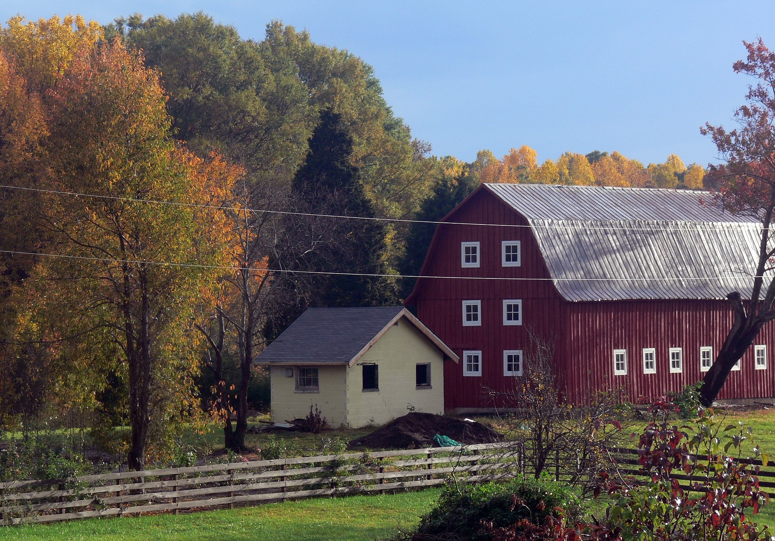
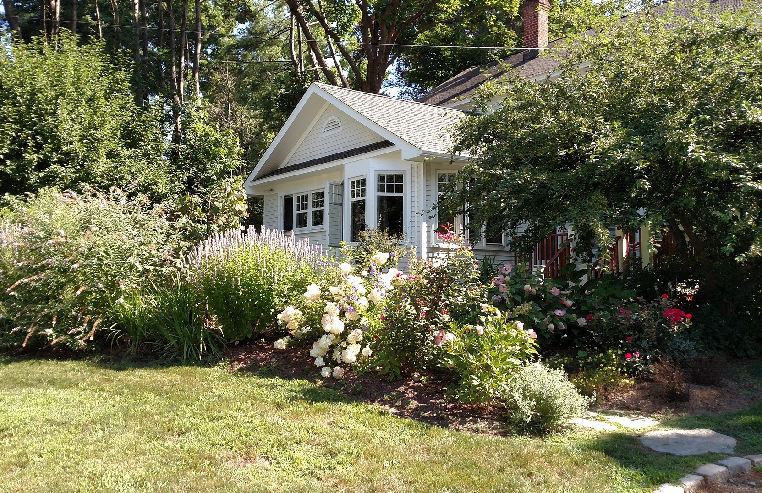
COMPOSTING 101
WHERE YOU LIVE CONSIDERATIONS
How much material to compost
Materials to compost
Time and energy to
compost
Plants to be planted
with compost

Slide 17
COMPOSTING 101
WHAT NOT TO
COMPOST
pet or human waste
meat, dairy or oil
diseased plants
pernicious weeds
wood ash

Slide 18
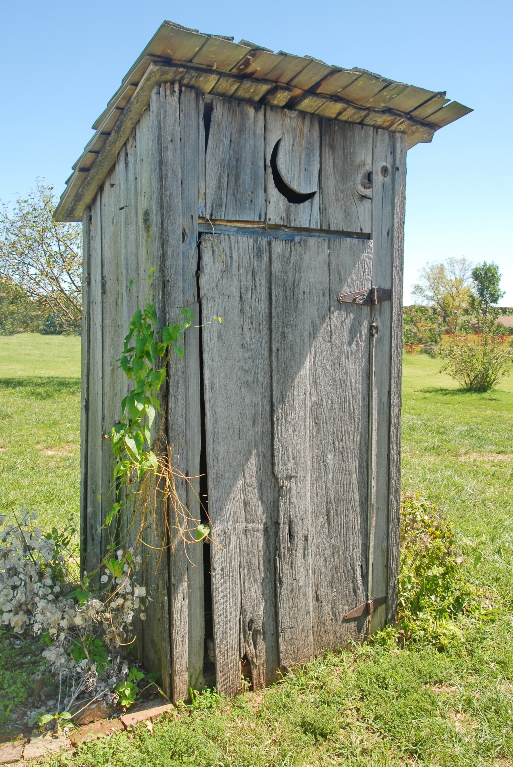
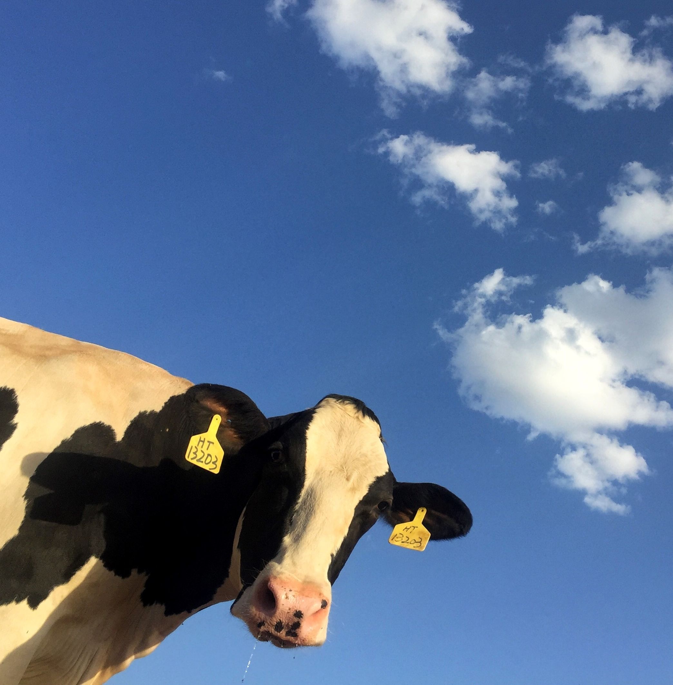
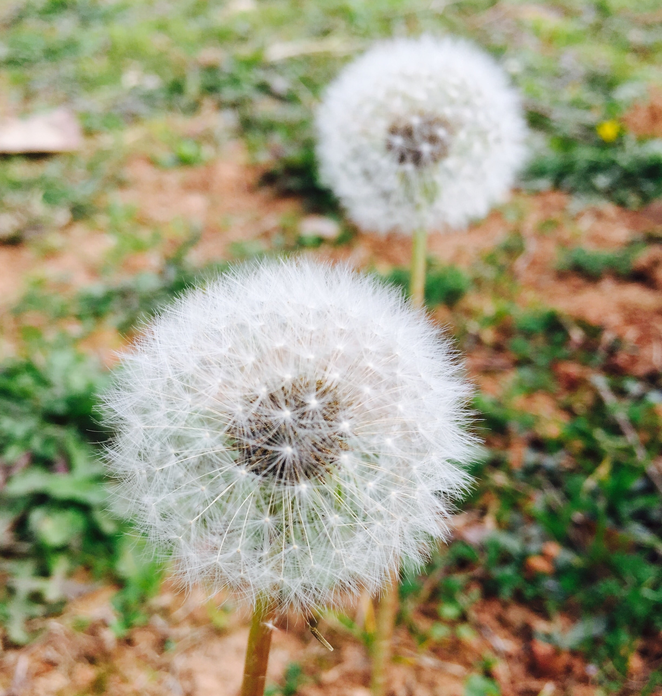
COMPOSTING 101
WHAT NOT TO COMPOST
 diseased plants
 pet or human waste
 meat, dairy or oil
 wood ash
 pernicious weeds

Slide 19
Do you have any questions?
Metro area Master Gardener™ Program

Slide 20
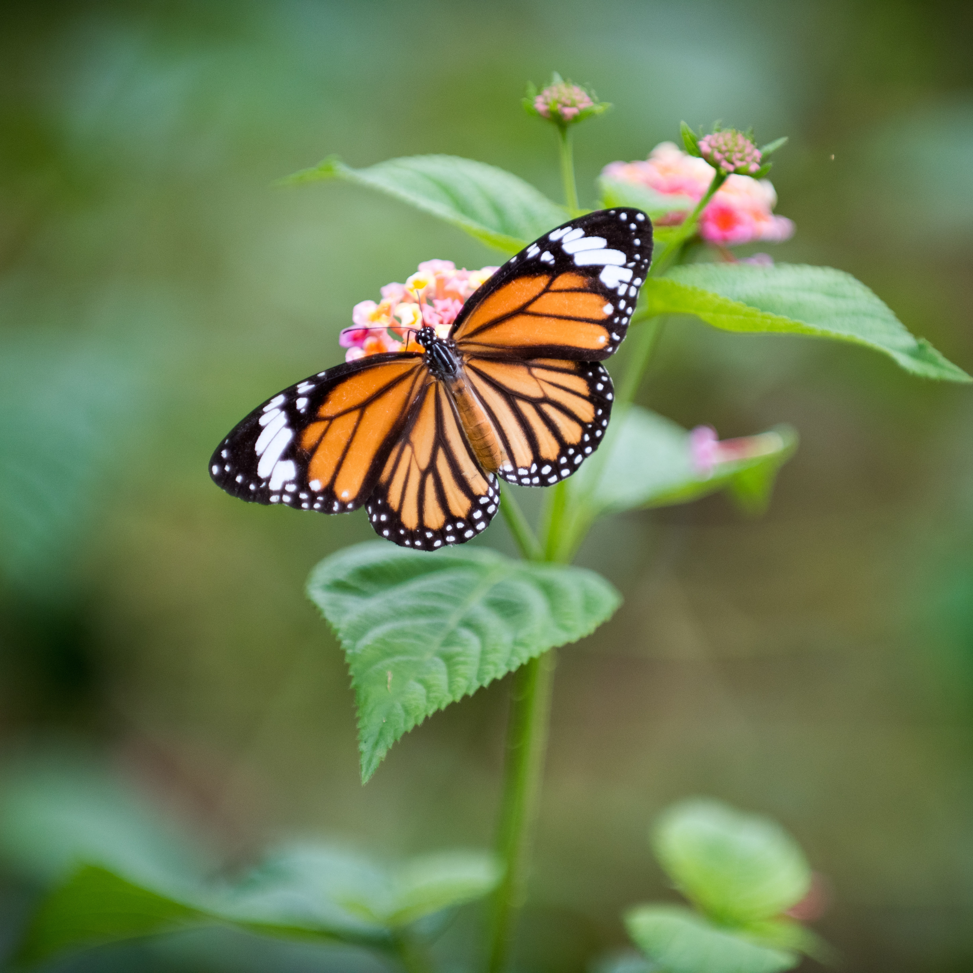
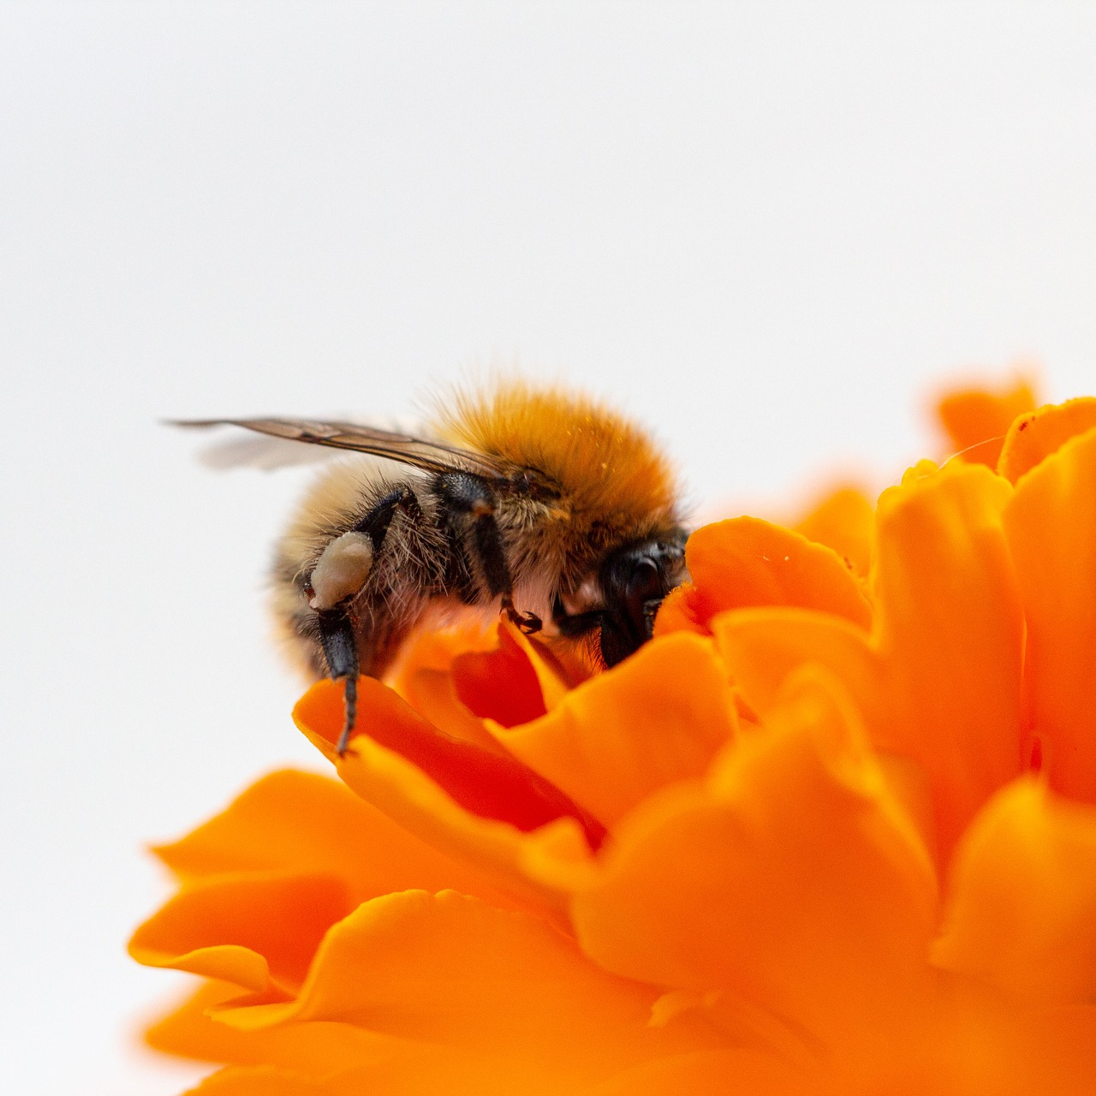
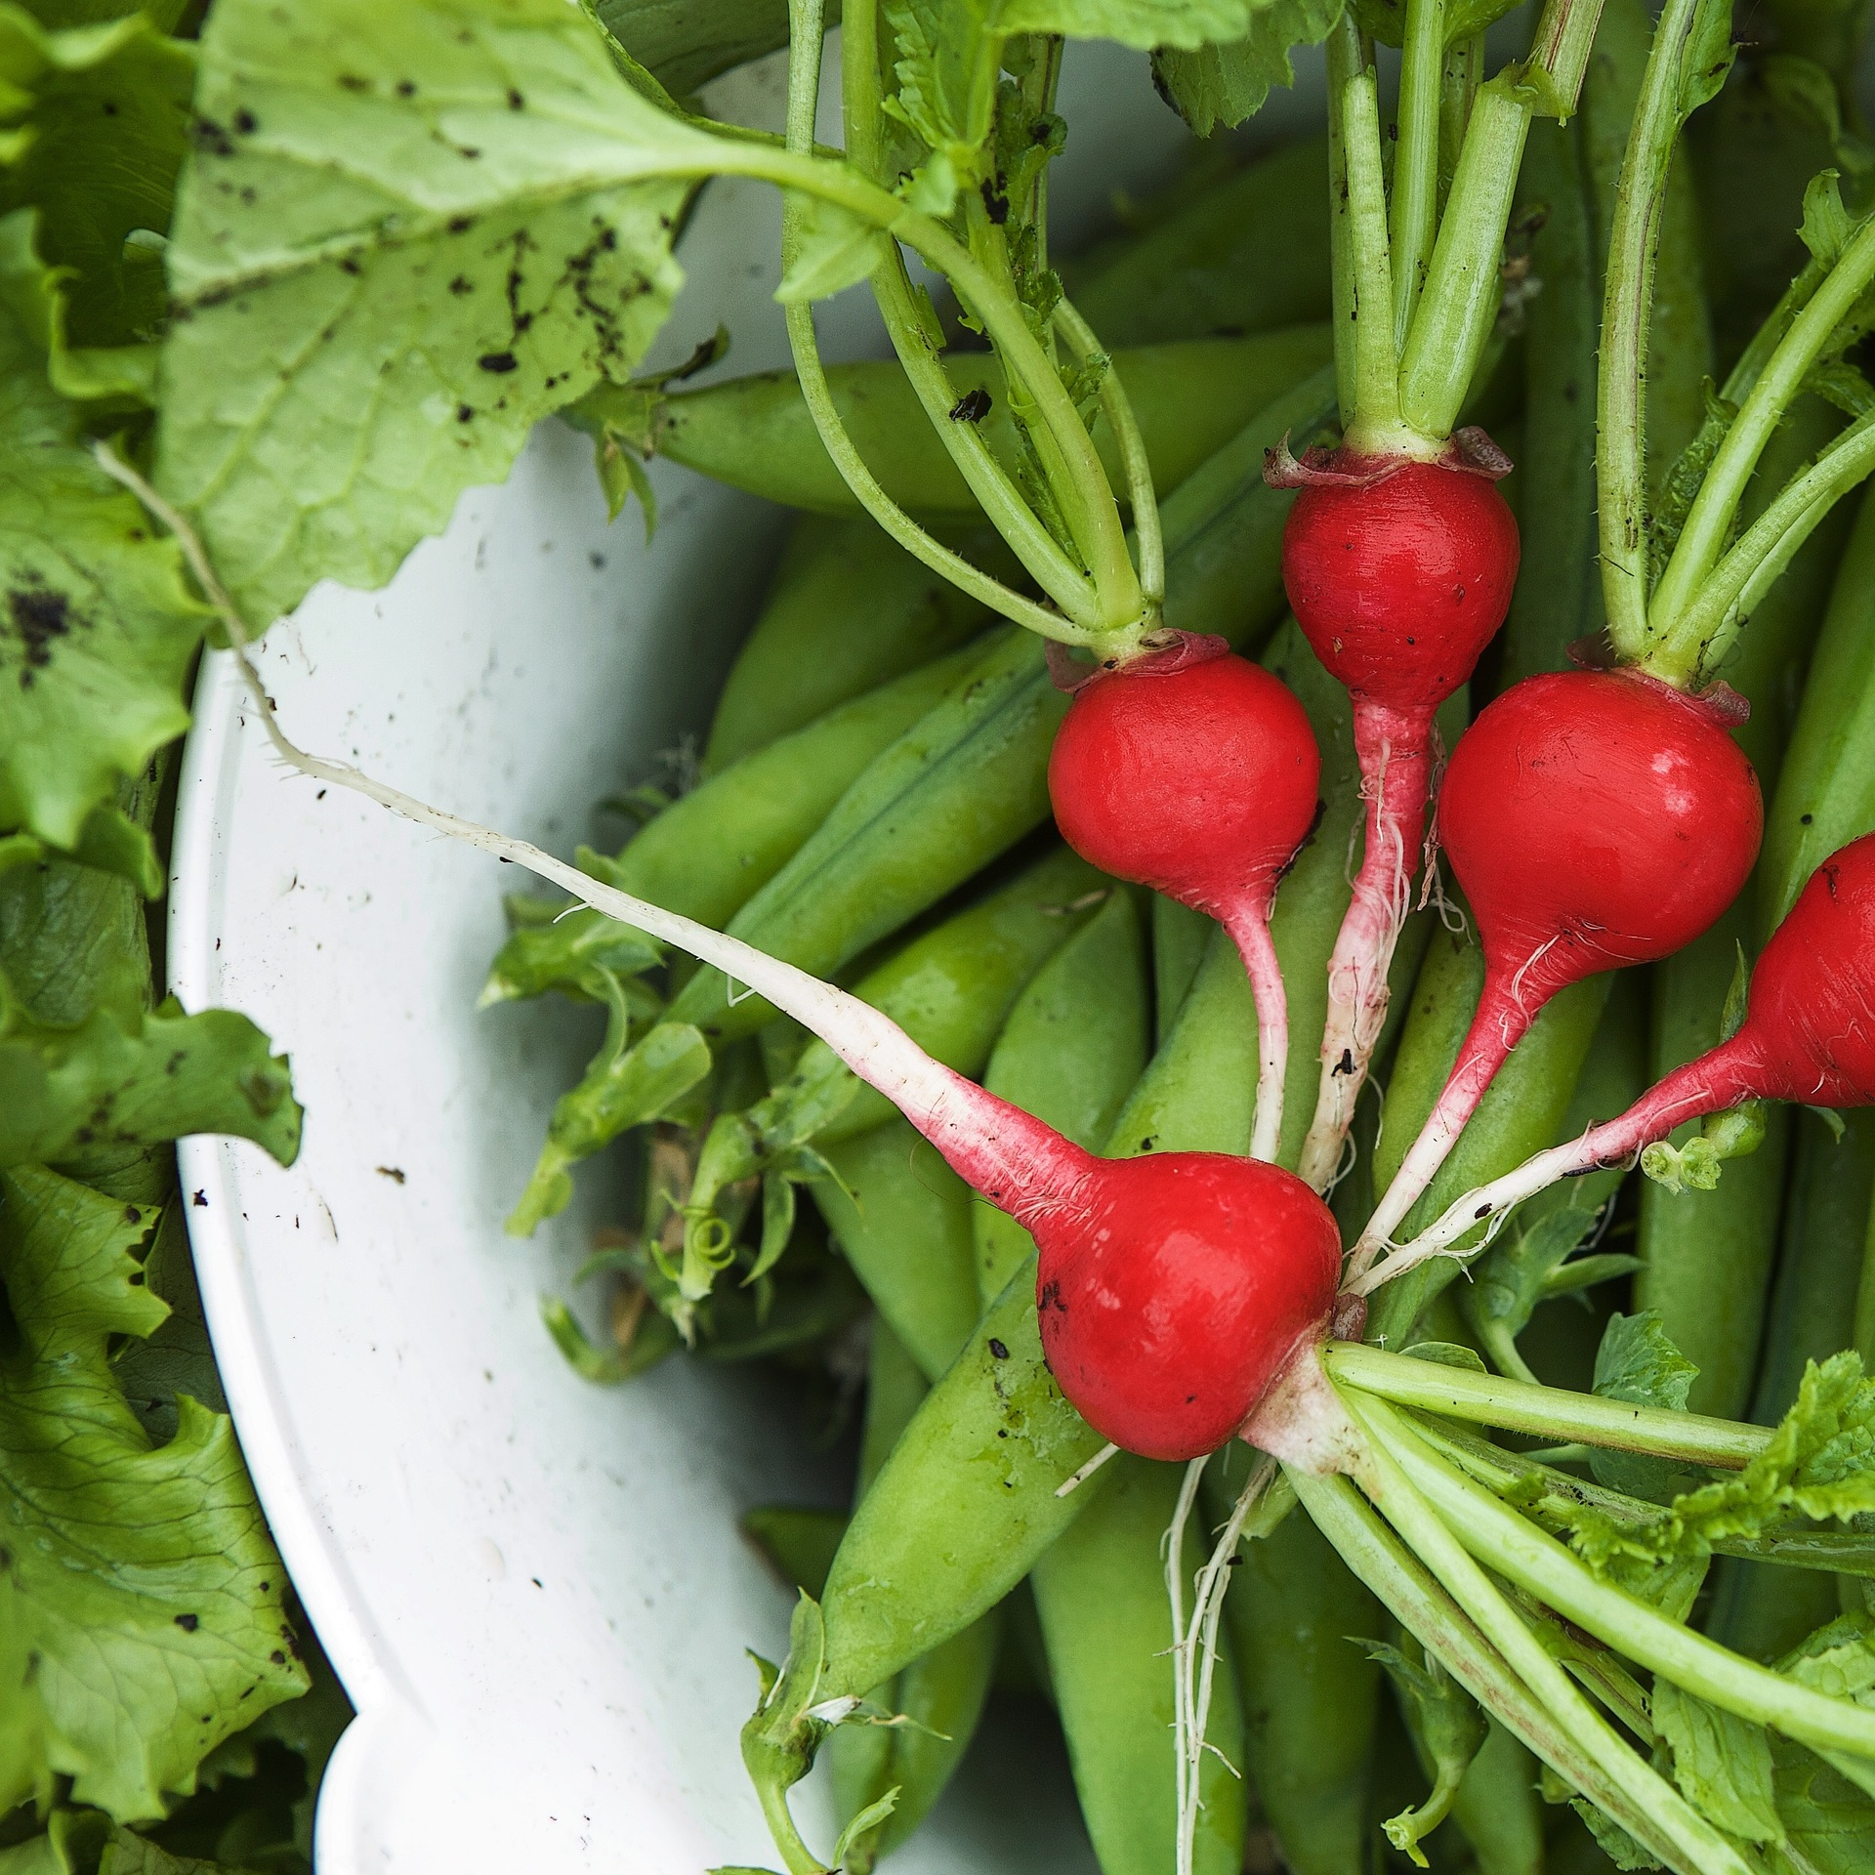
Where you can find us…
On the web
Twitter
Facebook
www.metromastergardeners.org
@TheRealDirt
@MetroMasterGardeners

Slide 21
OSU Extension provides information and expertise to help meet local challenges and help every Oregonian thrive.
4-H Youth Development
Agriculture and Natural Resources
Family and Community Health
Forestry and Natural Resources

Slide 22
Ask a Master Gardener™! via webform, voicemail or email by visiting our webpage…
www.metromastergardeners.org

